Slide 1

A Parallel Algorithm for Updating a Multi-objective Shortest Path in Large Dynamic Networks

Slide 2
Presented by:
22I-1026
22I-1076
22I-0969
Course:
Parallel and Distributed Computing
Instructor:
Aadil-Ur-Rehman

Slide 3
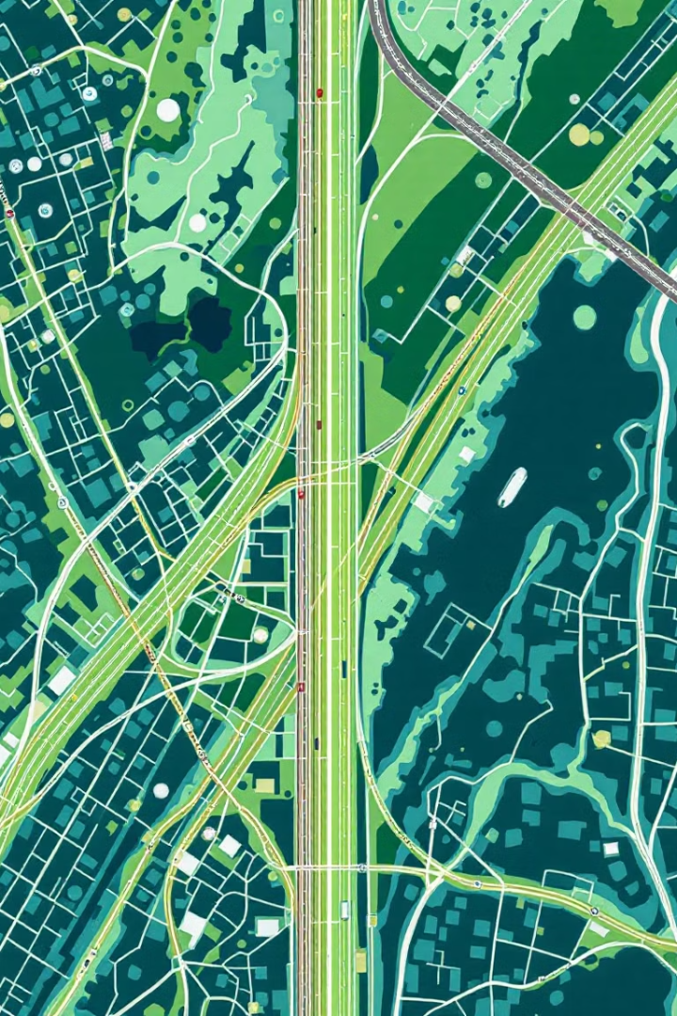
Introduction & Motivation
Real-world relevance
Many systems rely on shortest path calculations for routing and deliveries.
Dynamic challenges
Graphs frequently change with new roads or updated traffic data.
Efficiency concern
Recomputing from scratch wastes time and resources.
Multi-objective complexity
Need to optimize multiple goals like shortest distance and minimum fuel use.

Slide 4

Problem Statement
Goal
Multi-objective scope
Update shortest paths efficiently when new edges are added.
Focus on optimizing multiple conflicting objectives simultaneously.
Key requirements
Scalability, speed, and parallel execution to handle large dynamic networks.

Slide 5
Key Concepts
SOSP
MOSP
Pareto Optimality
Dynamic Networks
Shortest path based on a single criterion like time or distance.
Involves multiple objectives like travel time and energy use, often conflicting.
Improving one objective worsens another, so path choices are balanced.
Graphs that change over time, focusing here on edge insertions.

Slide 6

Key Contributions of the Paper
Parallel SOSP_Update
An algorithm that updates shortest paths after edge insertions.
Heuristic MOSP_Update
Computes one good Pareto-optimal multi-objective path quickly.
Practicality
Avoids NP-hard full MOSP search, favoring scalable heuristics.
Validation
Tested on large real networks, showing good scalability and speed.

Slide 7
SOSP_Update – How It Works
Edge grouping
Thread assignment
Path updating
Iterative propagation
New edges grouped by destination nodes to avoid race conditions.
Shorter paths update the node and mark it for further propagation.
One thread handles each group, ensuring safe parallel updates.
Changes spread to neighbors until stability is reached.

Slide 8

MOSP_Update – Heuristic Strategy
Separate objectives
Updates SOSP trees for each objective individually.
Combined graph
Creates one graph merging edges from all objective trees.
Edge weighting
Weights based on edge frequency; common edges get priority.
Final path
Runs SOSP on merged graph to find a balanced MOSP.

Slide 9
Our Parallelization Plan
MPI (Inter-node)
OpenMP/OpenCL (Intra-node)
METIS
Splits graph across machines; communicates on boundary changes.
Partitions graph for balanced workload and minimal communication.
Processes graph chunks in parallel threads within each node.

Slide 10
Scalability & Dataset Plan
Datasets
Measurements
Comparisons
road-usa
Total execution time
Sequential version
roadNet-PA
Speedup (multi vs single-thread)
MPI version
rgg_n_2_20_s0
Efficiency (time per updated node)
MPI + OpenMP version

Slide 11
Summary & Next Steps
Real-time importance
Dynamic shortest path updates are critical for evolving graphs.
Paper’s approach
Efficient parallel SOSP and heuristic MOSP update methods.
Our implementation
Using MPI for distribution, OpenMP/OpenCL for speed, METIS for partitioning.
Goal
Achieve high-speed, low-cost updates on large, dynamic networks.
Questions?
We welcome your queries and feedback.

